Slide 1

Computer Communications & Networks
CSNC-2413
Lec: 2
Computer Networking: A Top Down Approach 6th edition Jim Kurose, Keith Ross Addison-Wesley March 2012
Core Network, Performance

Slide 2
Chapter 1: roadmap
1.1 what is the Internet?
1.2 network edge
end systems, access networks, links
1.3 network core
packet switching, circuit switching, network structure
1.4 delay, loss, throughput in networks
1.5 protocol layers, service models
1.6 networks under attack: security
1.7 history

Slide 3

Packet Tx delay
application message broken into pkts of length L bits
pkts Tx into access network at transmission rate, R
R is link Tx rate, (link data rate, bps)
two pkts,
L bits each
2
1
R: link transmission rate
host
packet
transmission
delay
time needed to
transmit L-bit
pkt into link
L (bits)
R (bits/sec)
=
=
Total Tx delay for 2 pks = 2L/R secs

Slide 4
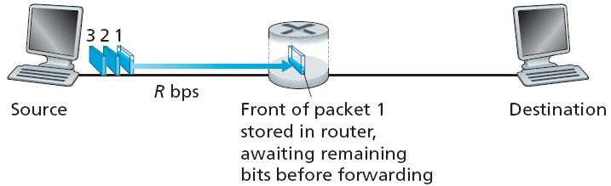
Store-and-forward (in pkt switching)
Store and Forward: entire pkt arrives at router, then Tx on next link
end-end delay (1 pkt) = 2L/R
end-end delay (3 pkts) = 4L/R
one-hop numerical example:
L = 7.5 Mbits
R = 1.5 Mbps
one-hop transmission delay = 5 sec
(assuming zero propagation delay)

Slide 5
Propagation delay
bits when put on the link, take a finite amount of time to travel from source to destination
bits travel with the speed of electromagnetic wave
‘s' is approx 3x10⁸ m/s
d: distance or link length
s: propagation speed
host
propagation
delay
d (m)
s (m/s)
=

Slide 6
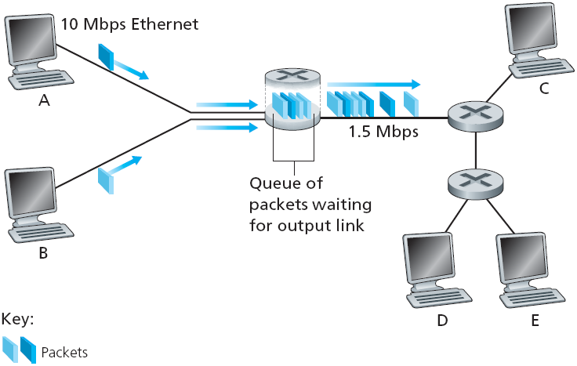
Queuing delay & loss
Queuing Delay & Loss: (at Router)
if pkt arrival rate at input links exceeds Tx rate of output link…
pkts will be queued, waiting for Tx (delayed)
pkts can be dropped, if buffer fills up (lost)
(lost pkt may be retransmitted by previous node, by source, or not at all)

Slide 7
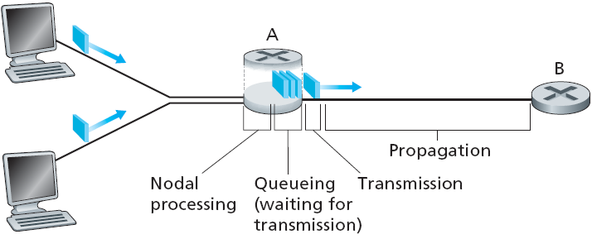
Four sources of packet delay
delay = d_{proc} + d_{queue} + d_{trans} + d_{prop}
d_{proc}: nodal processing
check for bit errors
determine output link
typically < msec
d_{queue}: queueing delay
time waiting at o/p link for Tx
depends on congestion level of router

Slide 8
Four sources of packet delay
delay = d_{proc} + d_{queue} + d_{trans} + d_{prop}
d_{trans}: transmission delay
L: packet length (bits)
R: link bandwidth (bps)
d_{trans} = L/R
d_{prop}: propagation delay
d: length of physical link
s: propagation speed in medium (~3x10⁸ m/sec)
d_{prop} = d/s
d_{trans} & d_{prop}
very different
Notes:
8

Slide 9

“Real” Internet delays & routes
What do “real” Internet delays look like?
Traceroute program: provides delay measurement from source to each router, along the path to dest
For all i…
send three pkts that will reach router i on path towards dest
router i will return pkts to sender
sender times the interval between Tx & reply
3 probes
3 probes
3 probes

Slide 10
“Real” Internet delays and routes
traceroute: gaia.cs.umass.edu to www.eurecom.fr
Three delay measurements from
gaia.cs.umass.edu to cs-gw.cs.umass.edu
1 cs-gw (128.119.240.254) 1 ms 1 ms 2 ms
2 border1-rt-fa5-1-0.gw.umass.edu (128.119.3.145) 1 ms 1 ms 2 ms
3 cht-vbns.gw.umass.edu (128.119.3.130) 6 ms 5 ms 5 ms
4 jn1-at1-0-0-19.wor.vbns.net (204.147.132.129) 16 ms 11 ms 13 ms
5 jn1-so7-0-0-0.wae.vbns.net (204.147.136.136) 21 ms 18 ms 18 ms
6 abilene-vbns.abilene.ucaid.edu (198.32.11.9) 22 ms 18 ms 22 ms
7 nycm-wash.abilene.ucaid.edu (198.32.8.46) 22 ms 22 ms 22 ms
8 62.40.103.253 (62.40.103.253) 104 ms 109 ms 106 ms
9 de2-1.de1.de.geant.net (62.40.96.129) 109 ms 102 ms 104 ms
10 de.fr1.fr.geant.net (62.40.96.50) 113 ms 121 ms 114 ms
11 renater-gw.fr1.fr.geant.net (62.40.103.54) 112 ms 114 ms 112 ms
12 nio-n2.cssi.renater.fr (193.51.206.13) 111 ms 114 ms 116 ms
13 nice.cssi.renater.fr (195.220.98.102) 123 ms 125 ms 124 ms
14 r3t2-nice.cssi.renater.fr (195.220.98.110) 126 ms 126 ms 124 ms
15 eurecom-valbonne.r3t2.ft.net (193.48.50.54) 135 ms 128 ms 133 ms
16 194.214.211.25 (194.214.211.25) 126 ms 128 ms 126 ms
17 * * *
18 * * *
19 fantasia.eurecom.fr (193.55.113.142) 132 ms 128 ms 136 ms
trans-oceanic
link
means no response (probe lost, router not replying)

Slide 11
Throughput
Throughput : data rate at which bits were transferred between sender & receiver (bits/sec)
Instantaneous : rate at given point in time
Average : rate over longer period of time
Consider that a file takes certain amount of delay to be transferred from Host A to host B
Average throughput, i.e, data rate achieved would be…
Avg Thruput (bps) = File size / delay

Slide 12
Consult book for next two slides

Slide 13

Bottleneck Link
Consider Server with file of F bits to send to Client…
If R_{s} < R_{c} What is average end-end throughput?
R_{s} bits/sec
R_{c} bits/sec
If R_{s} > R_{c} What is average end-end throughput?
R_{s} bits/sec
R_{c} bits/sec
bottleneck link
link on end-end path that limits end-end throughput

Slide 14
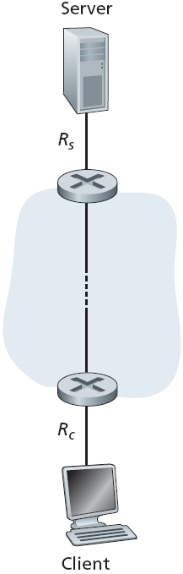
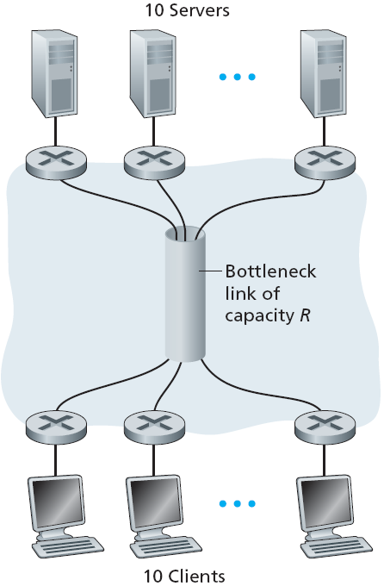
Throughput: Internet scenario
10 connections (fairly) share backbone bottleneck link R bits/sec
per-connection end-end throughput: min (R_{c}, R_{s}, R/10)
in practice: R_{c} or R_{s} is often bottleneck

Slide 15
Summary
1.1 what is the Internet?
1.2 network edge
end systems, access networks, links
1.3 network core
packet switching, circuit switching, network structure
1.4 delay, loss, throughput in networks
1.5 protocol layers, service models
1.6 networks under attack: security
1.7 history

